Slide 1
Alternative Access to Regulatory Annotations
Session 4
T6: Making the most of cis-regulatory annotations for genome-scale analysis
Gabriela A. Merino - Louisse Paola Mirabueno
Senior Bioinformatician, Ensembl Regulation, EMBL-EBI
Outreach Officer,
Ensembl Outreach,
EMBL-EBI
03/09/2026

Slide 2
Session map
File formats
Commonly-used format
Coordinates system
CREs and evidence files
How to get them
How they look
Considerations when working with multiple files and sources
Hands-on

Slide 3



Do not edit
How to change the design
Have you used some of the regulatory annotation resources we have presented?
Presenting with animations, GIFs or speaker notes? Enable our Chrome extension
Notes:
[LPM]
📣 This is Slido interaction slide, please don't delete it. ✅ Click on 'Present with Slido' and the poll will launch automatically when you get to this slide.

Slide 4

Do not edit
How to change the design
If you have previously used the regulatory annotation resources, how have you used them? E.g. single, locus analysis, file, etc.
Presenting with animations, GIFs or speaker notes? Enable our Chrome extension
Notes:
[LPM]
📣 This is Slido interaction slide, please don't delete it. ✅ Click on 'Present with Slido' and the poll will launch automatically when you get to this slide.

Slide 5

Do not edit
How to change the design
For your future work, how do you think would be the best way to access them?
Presenting with animations, GIFs or speaker notes? Enable our Chrome extension
Notes:
[LPM]
📣 This is Slido interaction slide, please don't delete it. ✅ Click on 'Present with Slido' and the poll will launch automatically when you get to this slide.

Slide 6
Commonly-used formats: BED and BigBed format
Standard format for representing genomic intervals and annotations.
It has three required fields and nine additional optional fields.
chrom: e.g. chr3, Y, NC_000001.11, scaffold10671.
chromStart: zero-based, included in the feature.
chromEnd: Not included in the display of the feature.
name
score
strand: Either "." (=no strand) or "+" or "-".
thickStart: The starting position at which the feature is drawn thickly (e.g., the start codon in gene displays).
thickEnd: The ending position at which the feature is drawn thickly.
itemRgb
blockCount, blockSizes, blockStarts: Blocks structure (i.e. exons)
Uses 0-based, half-open coordinates:
E.g: the first 100 bases of chromosome 1 are defined as chrom=1, chromStart=0, chromEnd=100, and span the bases numbered 0-99.
Notes:
[LPM]
Common file formats you will come across
Plain text files, tab-separated
Use plain text editor to open these files (e.g. Visual Studio Code, Sublime Text)

Slide 7
Commonly-used formats: BED and BigBed format
The number of fields per line must be consistent throughout any single set of data in an annotation track.
The order of the optional fields is binding: lower-numbered fields must always be populated if higher-numbered fields are used.
For very large BED datasets, UCSC recommends BigBed, which provides indexing and faster remote access.
Notes:
[LPM]

Slide 8
Do not edit
How to change the design
What type of track would you expect to be available as BED format?
Presenting with animations, GIFs or speaker notes? Enable our Chrome extension
Notes:
[LPM]
Genomic intervals/features
For enes, peaks, regulatory regions
📣 This is Slido interaction slide, please don't delete it. ✅ Click on 'Present with Slido' and the poll will launch automatically when you get to this slide.

Slide 9
Commonly-used formats: WIG and bigWig format
Stores and displays continuous genomic signal data displayed as graphs in genome browsers.
Designed for dense, continuous datasets with equally sized data elements.
Supports two formats:
variableStep: irregularly spaced positions
fixedStep: regularly spaced positions (more compact)
Structure:
Track definition line (track type=wiggle_0)
Declaration line (variableStep or fixedStep)
Data values (integer or floating-point, positive or negative)
Important consideration: Unlike BED format, it uses 1-based, fully closed coordinates.
UCSC recommends converting WIG files to bigWig for large datasets because it is indexed, faster to display, and more scalable.
E.g: the first 100 bases of chromosome 1 are defined as chrom=1, chromStart=1, chromEnd=100, and span the bases numbered 1-100.
Notes:
[LPM]

Slide 10
Commonly-used formats: bedGraph format
Stores and displays continuous-valued genomic signals.
Is similar to WIG, but preserves the original data values (no internal compression or binning).
Suitable for both dense and sparse genomic signal data.
Can store integer or floating-point values, including positive and negative numbers.
Structure
Track definition line (track type=bedGraph)
Data lines with 4 columns: chrom, chromStart, chromEnd, dataValue
It uses 0-based, half-open coordinates
Large text files can become inefficient; UCSC recommends bigWig for large datasets.
E.g: the first 100 bases of chromosome 1 are defined as chrom=1, chromStart=0, chromEnd=100, and span the bases numbered 0-99.
Notes:
[LPM]

Slide 11
Commonly-used formats: GFF3/GTF format
Standard formats for representing genome annotations, including genes, transcripts, exons, CDS regions, UTRs, and other genomic features.
Store both genomic coordinates and feature relationships (e.g., gene → transcript → exon).
Support hierarchical annotation of complex gene structures.
Human-readable, tab-delimited text formats containing 9 columns:
seqid (chromosome/scaffold)
source
type (gene, exon, CDS, etc.)
start
end
score
strand
phase
attributes
Use 1-based, fully closed coordinates.
E.g: the first 100 bases of chromosome 1 are defined as chrom=1, chromStart=1, chromEnd=100, and span the bases numbered 1-100.
Notes:
[LPM]
General Feature Format
Gene Transfer Format

Slide 12
Do not edit
How to change the design
What type of track would you expect to be available as GFF format?
Presenting with animations, GIFs or speaker notes? Enable our Chrome extension
Notes:
[LPM]
Genome annotations with feature relationships
For genes, transcripts, exons, CDS
📣 This is Slido interaction slide, please don't delete it. ✅ Click on 'Present with Slido' and the poll will launch automatically when you get to this slide.

Slide 13
Commonly-used formats: GFF3/GTF format
GTF (Gene Transfer Format)
Simpler format derived from GFF2.
Attributes typically include: gene_id, transcript_id, gene_name
GFF3 (General Feature Format v3)
More expressive and standardized than GTF.
Uses explicit parent-child relationships:
ID=
Parent=
Supports complex annotations, including alternative transcripts, regulatory elements, and non-coding features.
Better suited for genome annotation projects and data exchange.
Official Sequence Ontology standard.
Notes:
[LPM]

Slide 14
Commonly-used formats: Summary table
Format | Stores | Typical Use | Coordinates | Advantages | Recommended Large-Scale Version
BED | Genomic intervals/features | Genes, peaks, regulatory regions | 0-based, half-open | Simple, compact, widely supported | bigBed
bedGraph | Quantitative signal values across intervals | Coverage, expression, scores | 0-based, half-open | Preserves exact values; good for sparse or dense data | bigWig
WIG | Continuous signal data | Coverage tracks, probabilities, GC content | 1-based, closed | Compact representation for dense data | bigWig
GTF / GFF3 | Genome annotations with feature relationships | Genes, transcripts, exons, CDS | 1-based, closed | Rich annotation structure; supports gene models | — (text-based standard)
bigBed | Indexed binary BED | Large annotation datasets | 0-based, half-open | Fast access, efficient remote visualization | Current UCSC recommendation
bigWig | Indexed binary WIG/bedGraph | Large signal tracks | Depends on source format during conversion | Fast retrieval, scalable, browser-friendly | Current UCSC recommendation
Notes:
[LPM]
Summary of common file formats
Which format? Depends on data and tool!

Slide 15
Recommendations when working with multiple files
Before analysis, write down:
Where each file came from
Which release or registry version it represents
Which filters were applied before download
Which coordinate system do the file uses
Which assembly has been used to produce it
source | Ensembl / SCREEN / ENCODE / FAANG
version | release, registry version, retrieval date
assembly | GRCh38, GRCh37, mm10, ARS-UCD, etc.
file | URL, accession, checksum if available
filters | feature class, tissue, assay, status, cell type
coordinate system | BED or GFF convention; seqname style
Notes:
[LPM]
Good practice in data management: record as much as you can
Table with information about the files provided to attendees

Slide 16
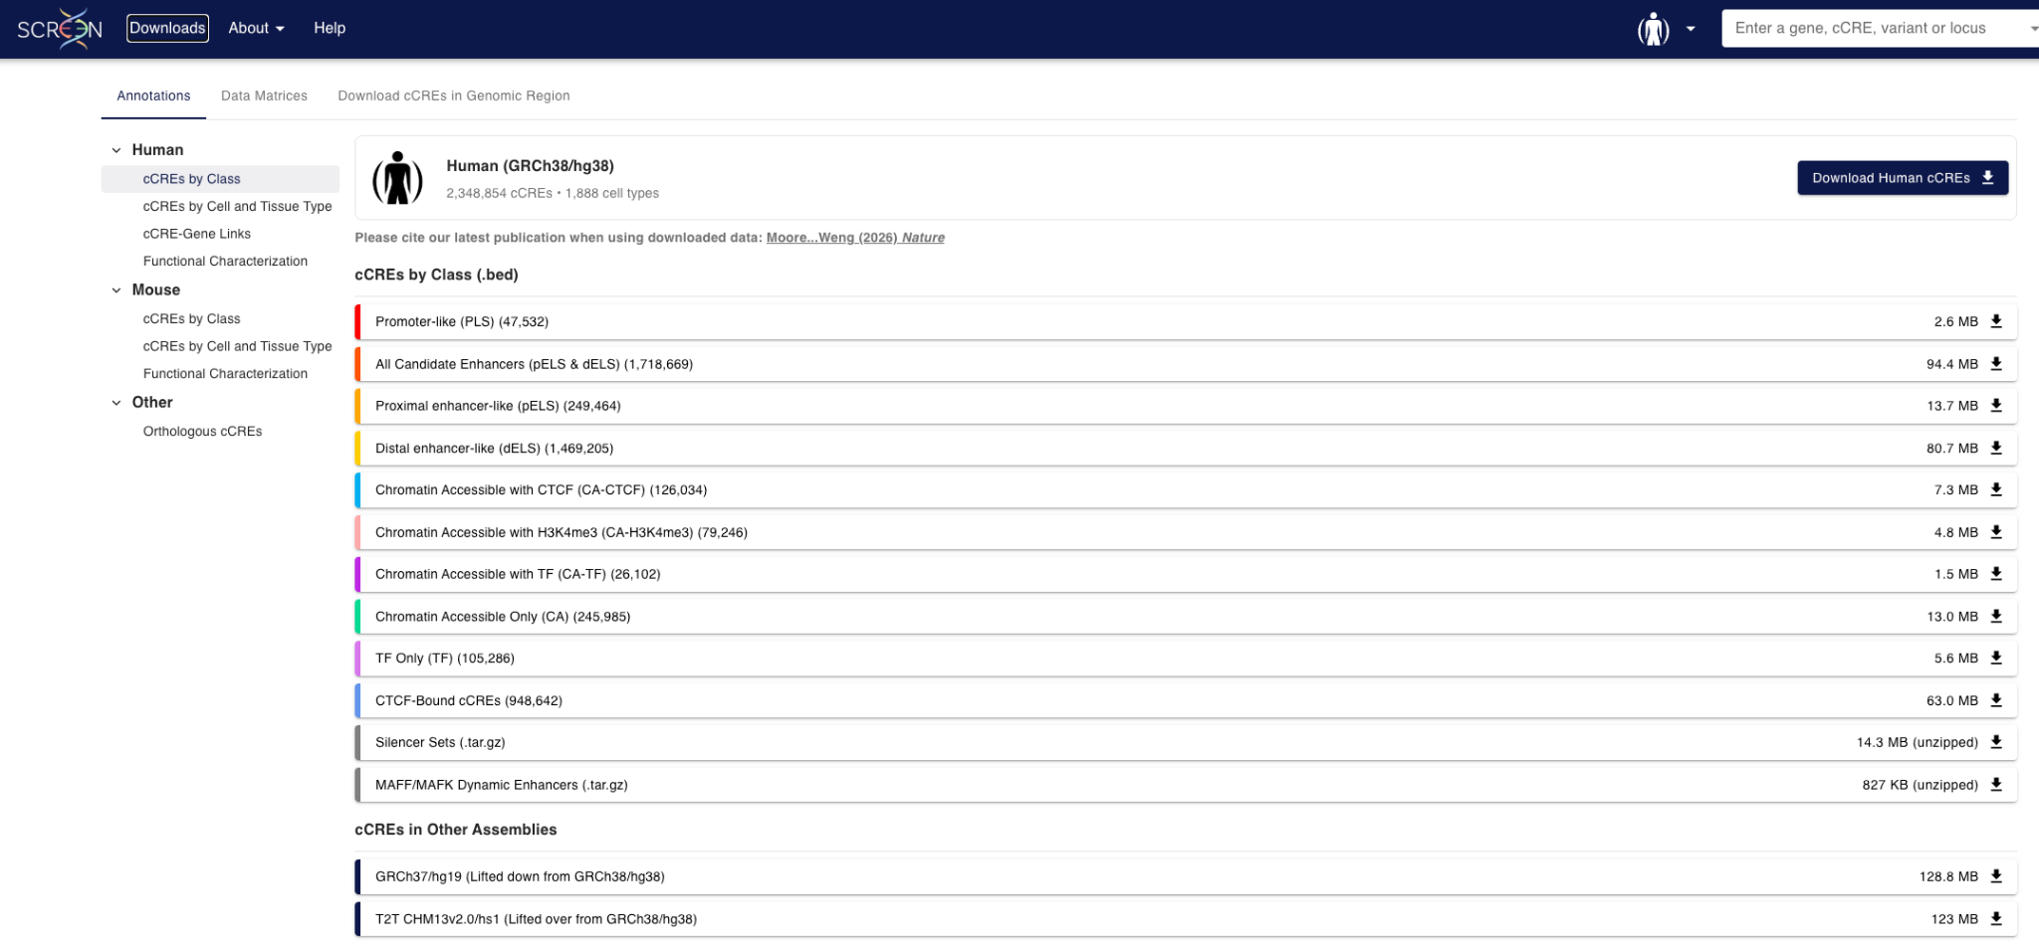
ENCODE cCREs annotation file
Notes:
[GAM]

Slide 17
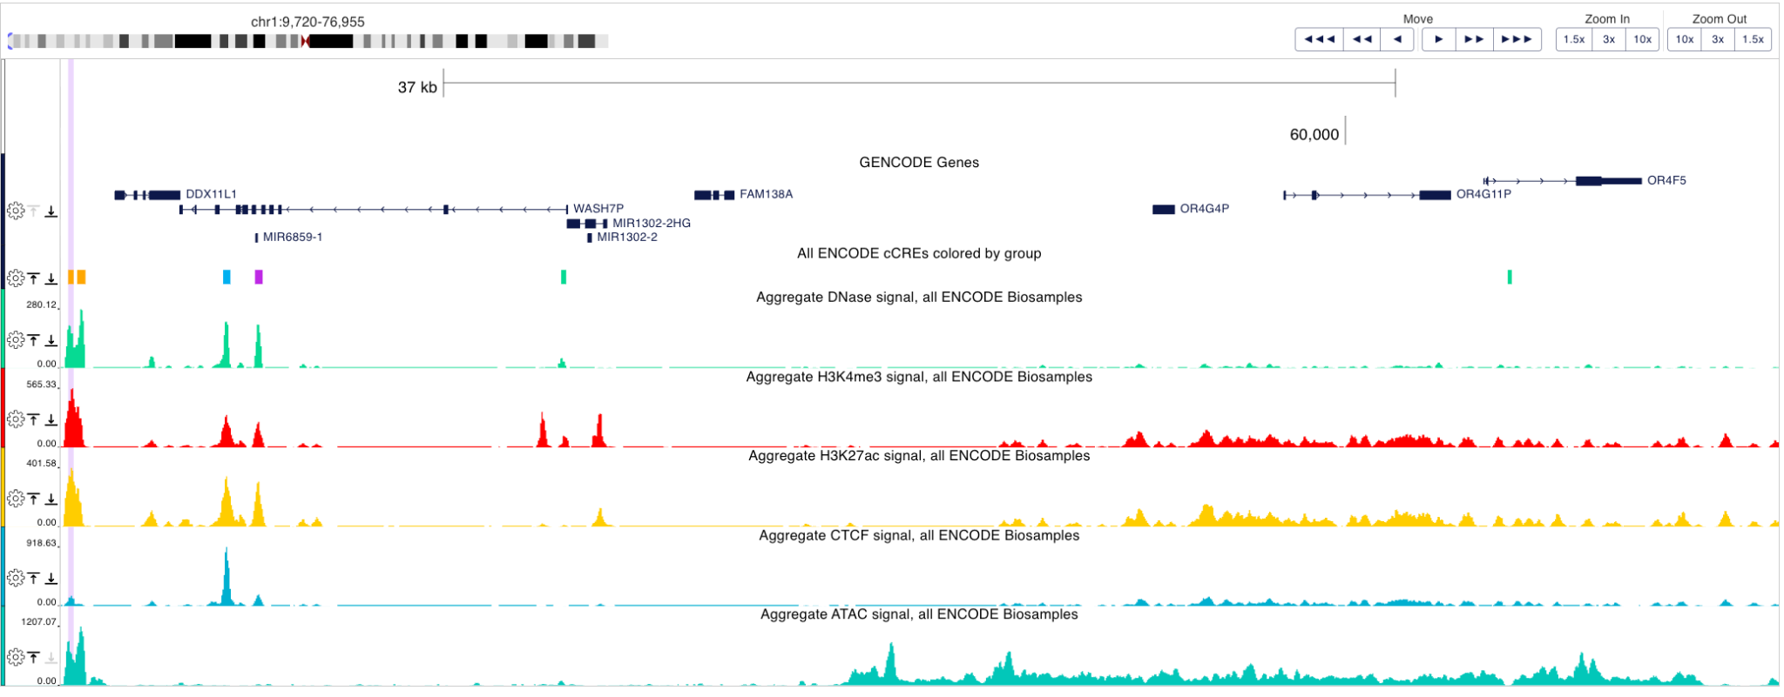
ENCODE cCREs annotation file
head -n 6 GRCh38-cCREs.bed
chr1 10033 10250 EH38D4327497 EH38E2776516 pELS
chr1 10385 10713 EH38D4327498 EH38E2776517 pELS
chr1 16097 16381 EH38D6144701 EH38E3951272 CA-CTCF
chr1 17343 17642 EH38D6144702 EH38E3951273 CA-TF
chr1 29320 29517 EH38D6144703 EH38E3951274 CA
chr1 66350 66509 EH38D4327503 EH38E3951275 CA
Notes:
[GAM]

Slide 18
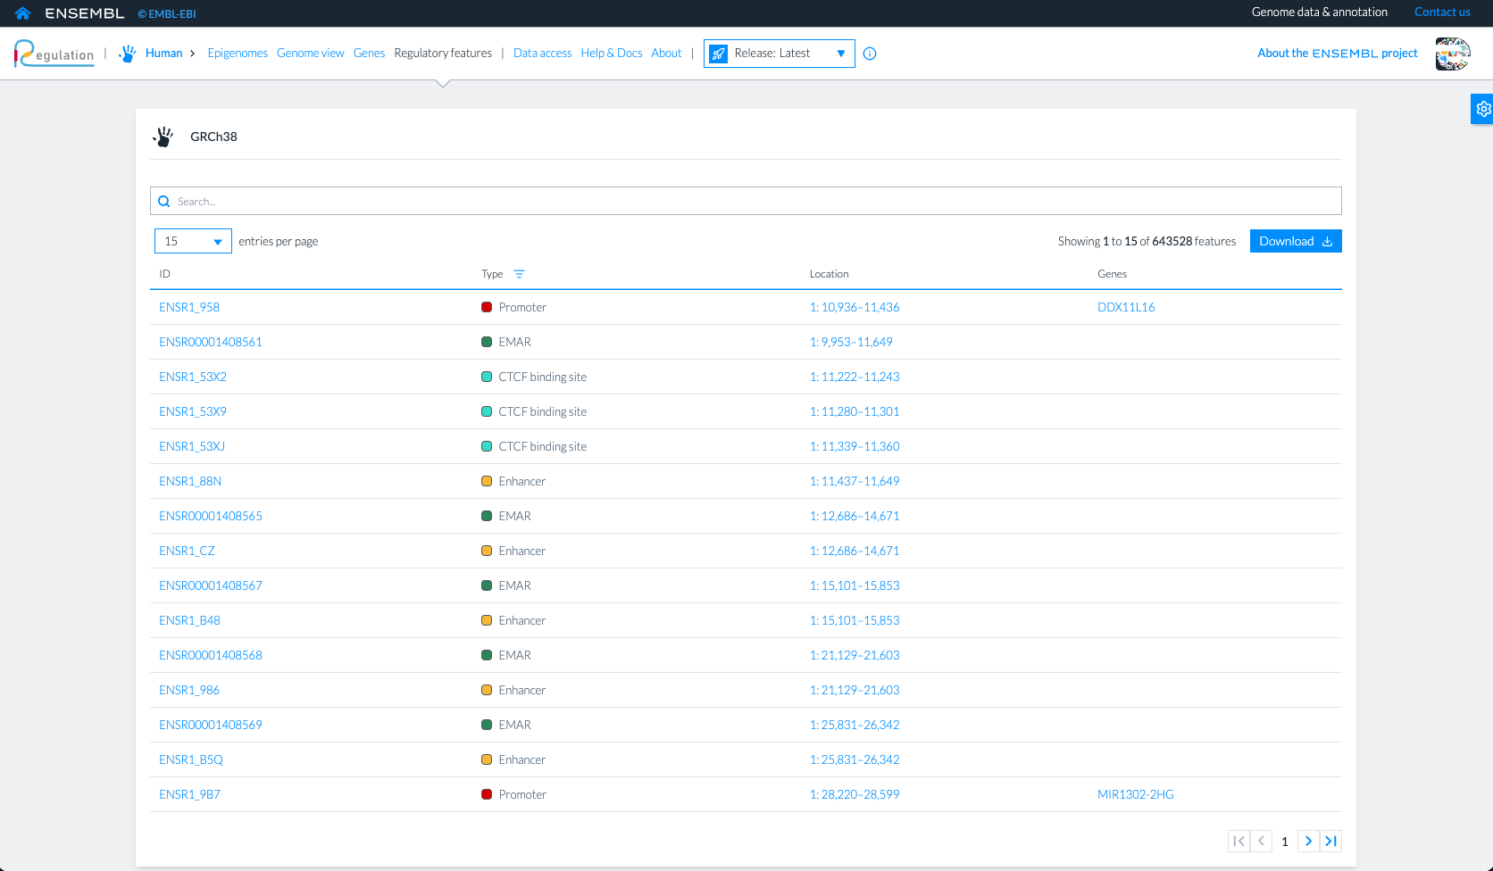
Ensembl Regulatory Features annotation file
Notes:
[GAM]
Update with the test site that will remove this button
Add data access screenshot

Slide 19
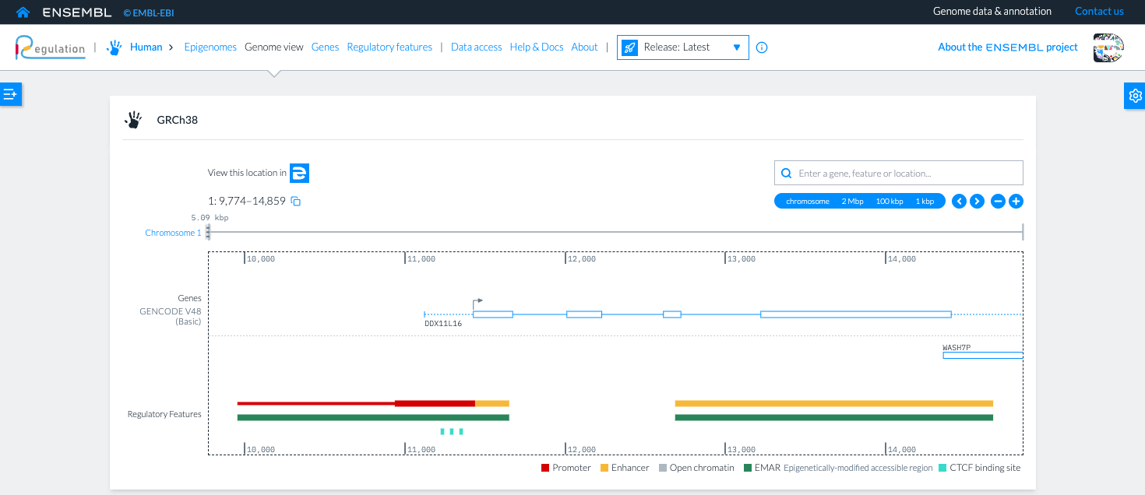
Ensembl Regulatory Features annotation file
head -n 8 Homo_sapiens.GRCh38.regulatory_features.v116.gff3
##gff-version 3
# Gene IDs in promoter attributes are from Ensembl release 114
1 Ensembl promoter 10936 11436 . . . ID=ENSR1_958;extended_start=9953;extended_end=11436;gene_id=ENSG00000290825;gene_name=DDX11L16;gene_biotype=lncRNA;color=#ff0000
1 Ensembl CTCF_binding_site 11222 11243 . + . ID=ENSR1_53X2;color=#40e0d0
1 Ensembl CTCF_binding_site 11280 11301 . + . ID=ENSR1_53X9;color=#40e0d0
1 Ensembl CTCF_binding_site 11339 11360 . + . ID=ENSR1_53XJ;color=#40e0d0
1 Ensembl enhancer 11437 11649 . . . ID=ENSR1_88N;color=#faca00
1 Ensembl enhancer 12686 14671 . . . ID=ENSR1_CZ;color=#faca00
Notes:
[GAM]

Slide 20
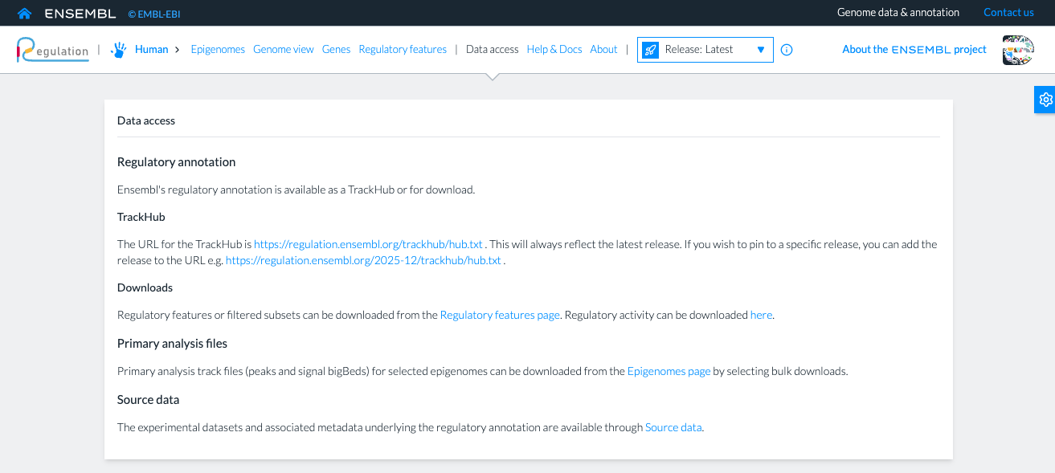
Ensembl Regulatory Activity file
Notes:
[GAM]

Slide 21
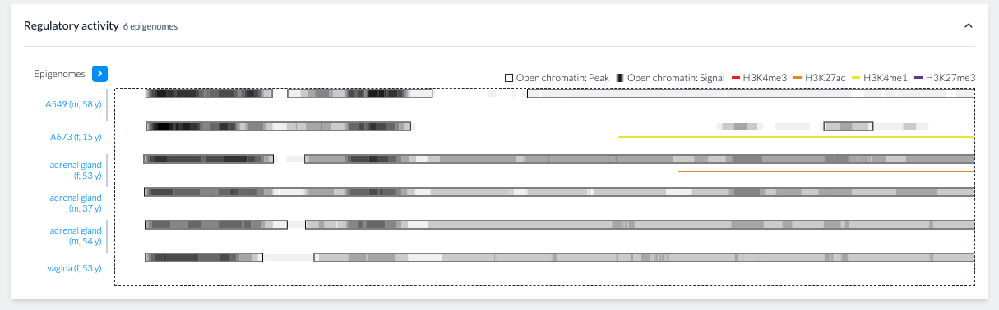
Ensembl Regulatory Activity file
head -n 2 Homo_sapiens.GRCh38.regulatory_activity.tsv
feature_id feature_type A549 (m, 58 y) A673 (f, 15 y) adrenal gland (f, 53 y) … vagina (f, 53 y)
ENSR1_958 promoter ACTIVE ACTIVE ACTIVE … ACTIVE
ENSR1_88N enhancer ACTIVE ACTIVE ACTIVE … ACTIVE
ENSR1_CZ enhancer ACTIVE ACTIVE ACTIVE … ACTIVE
ENSR1_B48 enhancer ACTIVE INACTIVE ACTIVE … ACTIVE
ENSR1_986 enhancer INACTIVE INACTIVE ACTIVE … ACTIVE
Notes:
[GAM]

Slide 22
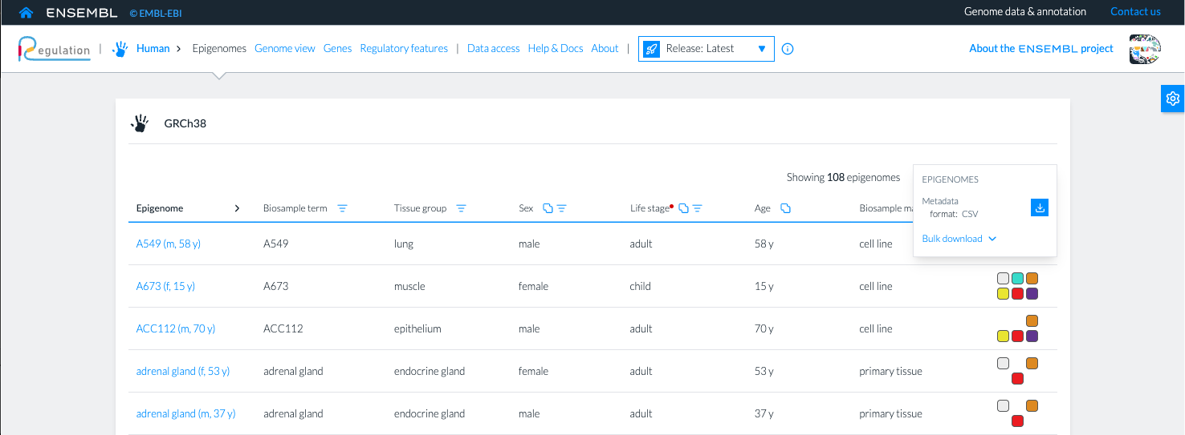
Ensembl Regulation Epigenomes Metadata
head -n 4 Homo_sapiens.GRCh38.metadata.2025-12.csv
epigenome,"biosample term","tissue group",sex,"life stage",age,"biosample material",assays
"A549 (m, 58 y)","A549","lung","male","adult","58 y","cell line","ATAC-seq, CTCF, H3K4me3, DNase-seq"
"A673 (f, 15 y)","A673","muscle","female","child","15 y","cell line","CTCF, H3K27ac, H3K27me3, H3K4me1, H3K4me3, DNase-seq"
"ACC112 (m, 70 y)","ACC112","epithelium","male","adult","70 y","cell line","H3K27ac, H3K27me3, H3K4me1, H3K4me3"
Notes:
[GAM]

Slide 23
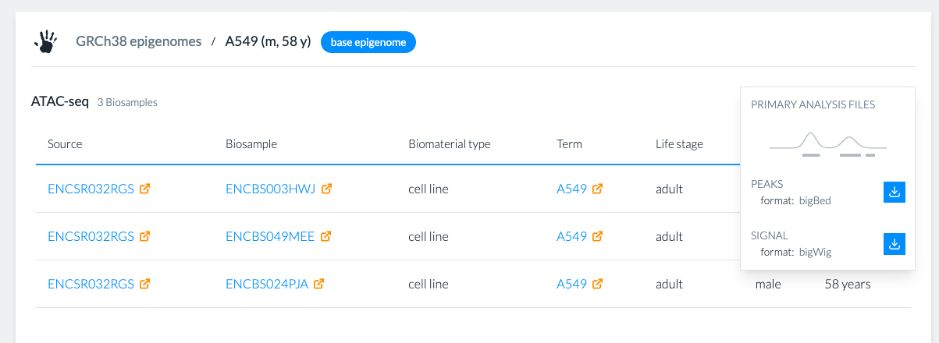
Ensembl Regulation Epigenome Peaks and Signals
Notes:
[GAM]

Slide 24
Questions?

Slide 25
Hands-on

Slide 26

Activity
Follow the example scripts that:
Read Ensembl Regulatory Features and SCREEN cCREs subsets.
Read user-defined regions and open chromatin peak files.
Inspect loaded datasets.
Overlap query regions with annotations.
Filter by feature class.
Identify specific features in the query regions.
Define active features using open chromatin evidence peaks.

Slide 27

R packages you must
Rtracklayer: Importing BED/GFF/GFF3 files
GRanges: Storing, manipulating, and analyzing genomic intervals.
findOverlaps: For variant or region intersection
dplyr, stringr: Data manipulation with functions for filtering, selecting, summarizing, and arranging data
ggplot2: highly-customizable data visualization

Slide 28

Python packages you must
PyRanges: Storing, manipulating, and analyzing genomic intervals.
pandas, re: Data manipulation and annotation parsing.
gffutils: Efficient querying and management of GFF/GFF3 feature annotations.
matplotlib, seaborn: Highly customizable data visualization.

